Slide 1

The Art of Hibernate Optimization
Bryce Penberthy
Daugherty Business Solutions

Slide 2



Slide 3


Misconceptions
I don’t have control over SQL commands
Hibernate generates too many queries
Populating my domain objects will make my app too slow

Slide 4
Reality
Many optimizations exist that most people don’t take advantage of.
Some optimizations can be done with little to no code changes.
Hibernate is designed to work best if you’re using Object Oriented design.

Slide 5
Preparation
Install / Set up your favorite IDE
If you want to use Eclipse, install eGit & m2e plugins
Example code can be found on GitHub: <place URL here>

Slide 6
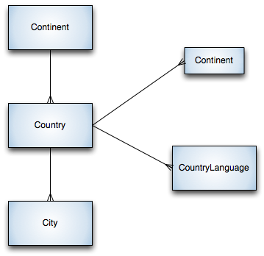
Example database
MySQL world database example / Converted to HSQL
http://dev.mysql.com/doc/world-setup/en/world-setup.html

Slide 7
First Steps
Take Control of your SQL
Turn on SQL output
Modify HQL to reduce the number of database queries Hibernate needs to make.
Force collections to be eager loaded by using JOINs

Slide 8
Forcing HQL to Pre-Fetch
From
@Override
public Country find(String countryName) {
return (Country) entityManager.createQuery(
        "from Country country where country.name = :countryName")
.setParameter("countryName", countryName).getSingleResult();
}
To
@Override
public Country find(String countryName) {
return (Country) entityManager.createQuery(
        "select country “ +
        “from Country country left join fetch country.cities “ +
        “where country.name = :countryName")
.setParameter("countryName", countryName).getSingleResult();
}

Slide 9
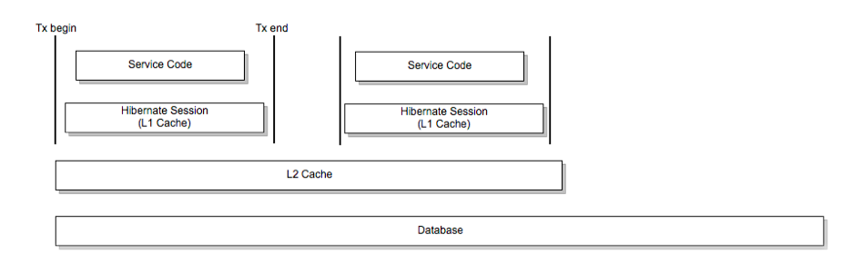
Object Cache
Hibernate Session cache remembers objects in the same transaction
L2 Cache remembers objects across requests
Database remembers objects indefinitely

Slide 10
L2 Cache Implementations
Cache | Type | Cluster Safe | Query Cache Supported
EHCache | Memory, Disk |  | Yes
OSCache | Memory, Disk |  | Yes
SwarmCache | Clustered | Yes
JBoss Cache 1.x | Clustered | Yes (Replication) | Yes
JBoss Cache 2 | Clustered | Yes (Replication or invalidation) | Yes
*Hibernate Documentation Table 19.1
http://docs.jboss.org/hibernate/core/3.3/reference/en/html/performance.html#performance-cache

Slide 11
Optimizing for the Cache
Rely on lazy loading for cached objects
Don’t ask for the same data twice in the same service.
Use Query Caching carefully

Slide 12
Setting up L2 Cache
Persistence.xml (or Hibernate config)
<property name="hibernate.cache.region.factory_class"
  value="net.sf.ehcache.hibernate.EhCacheRegionFactory" / >
<property name="hibernate.cache.use_second_level_cache" value="true" />
<property name="hibernate.generate_statistics" value="true" />
<property name="hibernate.cache.use_query_cache" value="true" />

Slide 13
EhCache Configuration
<ehcache>
<defaultCache
maxEntriesLocalHeap="10000"
eternal="false"
timeToIdleSeconds="120"
timeToLiveSeconds="120"
overflowToDisk="true"
maxEntriesLocalDisk="1000000"
diskPersistent="false"
diskExpiryThreadIntervalSeconds="120"
memoryStoreEvictionPolicy="LRU"
/>
<cache name="com.servolabs.world.domain.Continent"
maxEntriesLocalHeap="1000"
eternal="false"
timeToIdleSeconds="300"
timeToLiveSeconds="600"
overflowToDisk="false"
/>
...

Slide 14
Using Query Cache
ehcache.xml
<!-- This is an example of a named query cache -->
<cache name="countryQueryCache"
maxEntriesLocalHeap="100"
eternal="false"
timeToLiveSeconds="86400"
overflowToDisk="true"
/>
Query query = entityManager
    .createQuery("from Country country where country.region = :regionName")
.setParameter("regionName", regionName);
// If you're using the Hibernate API directly, use setCachable(true) and
  // setCacheRegion("countryQueryCache") calls
query.setHint("org.hibernate.cacheable", true);
query.setHint("org.hibernate.cacheRegion", "countryQueryCache");
return query.getResultList();

Slide 15
That’s all for now!
Get my sample code from https://github.com/brycep/world-example. Feel free to play around with it, use it for your own apps, presentations or anything you want. Have fun!
Any Questions?

